Slide 1
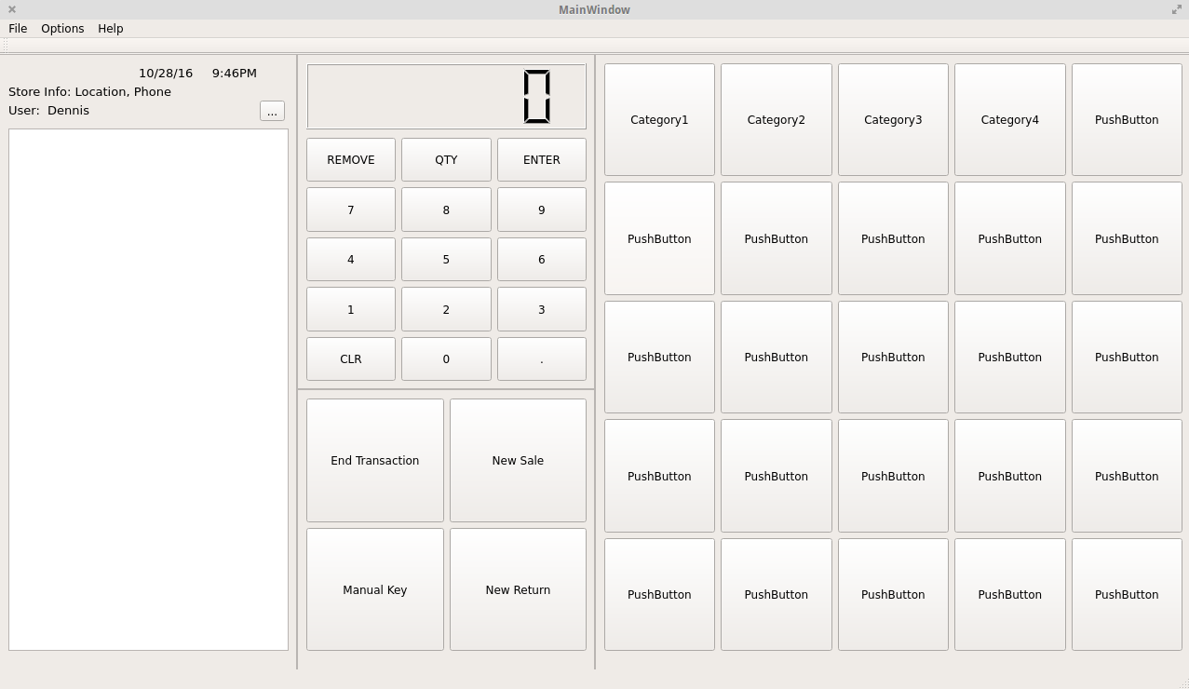
Checkout
Ingvild Kongsgaard
Kayla Libuszowski
Dennis Mesina
Harjinder Gill
Matt Miller
Mayank Choudhary
Logan Garcia

Slide 2
Sprints
Sprint 1: Initial Design and Skeleton Files
Sprint 2: Implementation of Files and Initial Research of GUI
Sprint 3: Flat File Support and Mock GUI Windows
Sprint 4: Finish Design of GUI and Start Tying Backend to Frontend
Sprint 5: Finish Tying Backend to Frontend

Slide 3
Use Cases
Keep track of multiple stores
Keep track of individual products
- Add or remove products
Have an inventory for each store
- Warehouse feature inside inventory
Employee clocking in and out
- Keep track of hours, sick time, vacation time, sales, etc.
Implement sales/discounts that affect certain items
Monthly sales goals for each employee and store

Slide 4
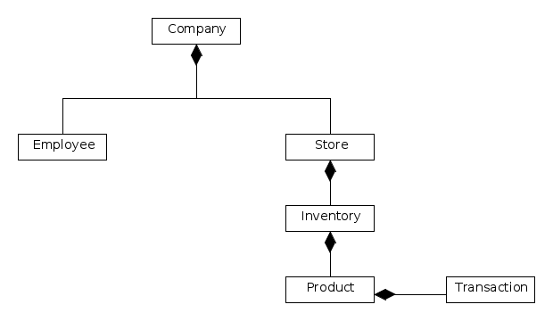
UML Diagram

Slide 5
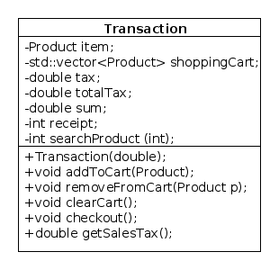
Structural Diagram - Transaction

Slide 6
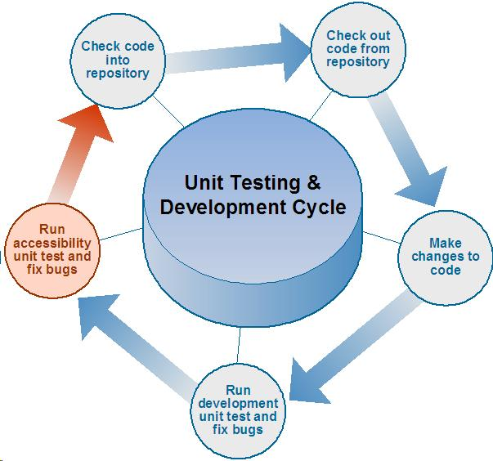
Test Plan

